Slide 1
Trabajar en el corazón del cambio
Tech Transformation
April 2021

Slide 2
Transformation overview
Women in tech

Slide 3
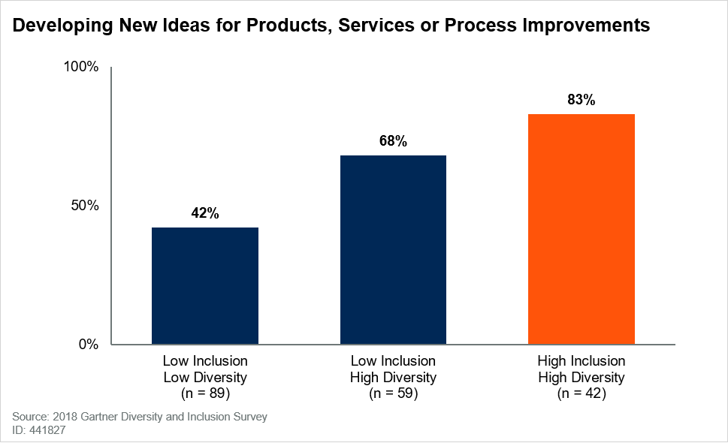
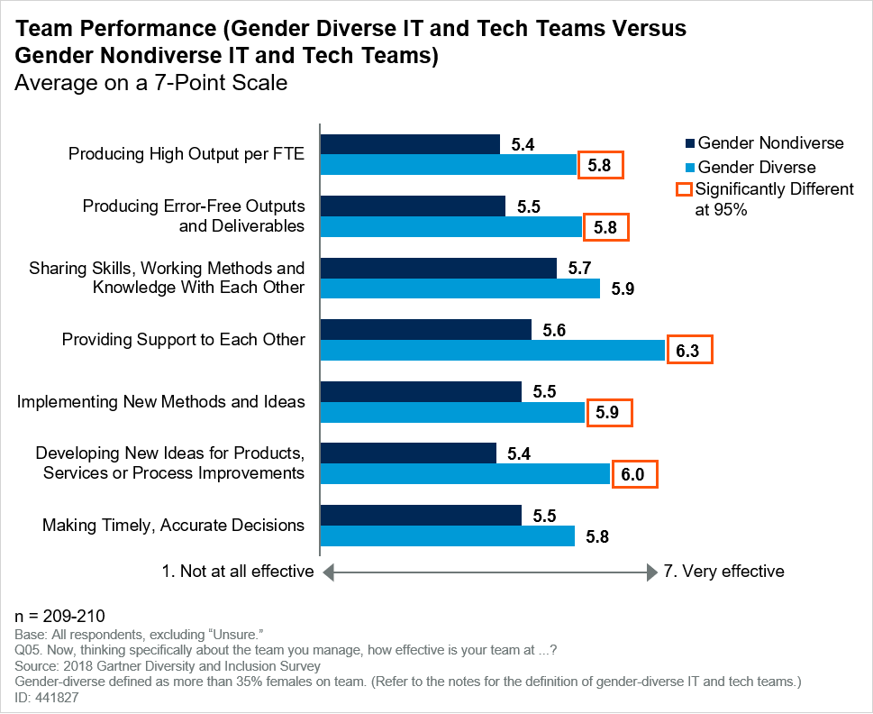
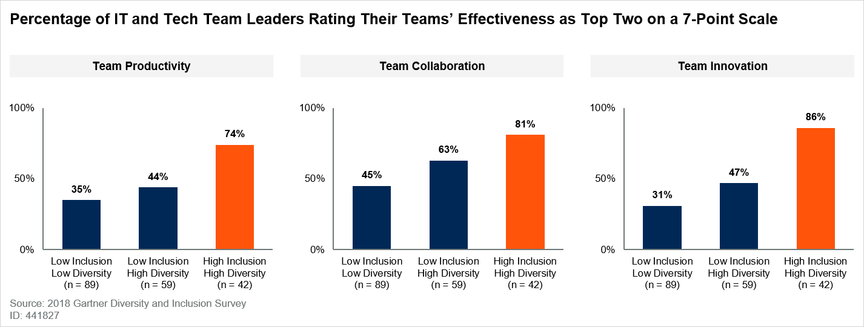
Women in Tech Transformation pays dividends
Gender-diverse IT and tech teams are more likely to outperform less-diverse IT and tech teams on team performance measures
High Gender-Diverse and High-Inclusion IT and Tech Teams Perform Better at Ideation Than Low Gender-Diverse and Low-Inclusion IT and Tech Teams
59%
CTOs lead technology innovation teams and diversity could improve their success
Tech skilling drives tech resilience.
Building in-house tech women talent decreases risk associated with relying on contract talent and allows for smoother transition post-transformation.
Data insights:
Only 9% of Organizations in a Gartner survey Had a Female CTO
CTOs are the technology visionaries who leverage the emerging technologies that enable business model change.
Organizations with diversity in employee personality types are more likely to have better business outcomes
Gartner ID: G00441827
Copyright © 2021 Accenture. All rights reserved.
3

Slide 4
Technology Transformation
Critical components of Tech/Digital Transformation
2021 CEO Obstacles:
#1: COVID-19 related disruptions
#2: Lack of quality and mix gender talent¹
Technology Workforce
Pivoting existing talent through intentional and dedicated investment in skills, culture and experience.
Over 75% of IT decision-makers are dealing with skills gaps.²
Technology Strategy
The strategy to modernize technology and transform digital capabilities at scale and speed.
80% of cloud leaders reported finding it easier to upskill existing talent than to hire for new skills.³ and the mix gender will be relevance
94% of employees are more likely to stay long-term with an employer who invests in their career through skills development.³
Scaled Agile Operating Model
Application of agile framework to design, implement, and deliver value-led capabilities and features.
Successful transformations spend 20-25% of the total budget on their workforce.
Technology Architecture
Boundaryless, future-ready systems of leading and complex technologies to deliver products and services.
¹C-Suite Challenge, Conference Board; ² 2020 IT Skills and Salary Report | Global Knowledge; ³2020 State of Cloud Learning Report; A Cloud Guru
Copyright © 2021 Accenture. All rights reserved.
4

Slide 5
Embedding new
ways of working
Womens Roles in transformation

Slide 6
Priority Categories
Tech skill
Tech Architecture Capability to design and implement holistic technology initiatives across value streams
Data Analytics Understanding of the core principles to structure, analyze, manage, and report org data ,
Enterprise Architecture
Cloud Computing
Cloud Platforms (e.g. Azure, AWS)
Information Framework (SID)
Data Modeling & Analysis
Neural Networking
R & MySQL
Data Visualization with Power BI
Modern Engineering Expertise in the design, development, release, and sustainment of tech solutions
DevOps Knowledge of the practices and tools that enable high-speed, iterative development
Microservices & APIs
Performance & Quality Engineering
Containerization
Programming (e.g. Python, Java, GO)
Application Performance
CI/CD Methodologies
Test Automation
Source Code Management
Agile Methodology Application of agile frameworks (e.g. SAFe) to design, implement, and manage technology projects
Cyber Security
Lead detection, response, and prevention of cyber incidents within the organization
Agile Development & Delivery
PI Planning & Agile Ceremonies
Agile Collaboration (e.g. Jira)
Network Security
Threat Intelligence
Security Test Tools (e.g. Fortify)
Copyright © 2021 Accenture. All rights reserved.
6

Slide 7
Priority Modern Technology Roles
*This document contains content from the Technology Role Library which is Accenture intellectual property that is solely owned by Accenture.
These roles were selected from the Technology Role Library* based on Accenture experience leading client Tech Org transformations, coupled with inputs from SkyHive, Talent Neuron, and Burning Glass. These roles are collectively the most client relevant relative to technology modernization, meaning they are either:
Critical to a client’s transformation efforts
Difficult to fill
In high demand, with high demand skills
Reflect emerging skills
Emerging Technologist
Solution Architect
Cloud Engineer
Cloud Operations Manager
SRE (Site Reliability Engineer)
AI/ML Engineer
Data Scientist
Security Analyst
Agile Coach
DevSecOps Engineer
Full Stack Engineer
Cloud Architect
Technology Risk & Compliance Manager
Cloud Value Architect
Business Continuity/Disaster Recovery Manager
Cloud Deployment Manager
Automation Engineer
Platform Engineer
Security Risk Manager
Cloud Security Architect
Cloud Security Engineer
Agile Development Manager
DevSecOps Architect
DevOps Engineer
Change & Communications Manager
Business Analyst
Journey Design Lead
Cloud Sales Representative
Cloud Cost Optimization Manager
Enterprise Architect
Cloud Native Developer
Network Engineer
Data Analyst
Engineering Manager
Data Visualization Engineer
Quantum Data Engineer
User Experience Designer
Product Owner
Agile Developer
Business Owner
Epic Owner
Product Manager
Release Train Engineer
Scrum Master
Solution Manager
Solution Train Engineer
System Architect / Engineer
Quality Assurance Engineer
Identification of critical ROLEs
Copyright © 2021 Accenture. All rights reserved.
7

Slide 8
Tech Role Library
New skilling
illustrative
Strategy & Lighthouse | Business Engagement | Project Management | Technology Service Management
Change & Communications Manager Emerging Technologist Future Workforce Architect Technology Customer Journey Strategist Technology Portfolio Strategist Technology Risk & Compliance Manager Technology Strategy Manager Vendor Manager | Business Analyst Business Engagement Manager | Program Manager Project Manager | Asset Manager Business Continuity/Disaster Recovery Manager Change Manager Configuration Manager Data Center Architect Incident Manager
Technology Architecture | Technology Engineering |  | Data & Analytics | Security
Data Architect Enterprise Architect Platform Architect Solution Architect | AI/ML Engineer API Engineer Automation Engineer Cloud Engineer ML Platform Engineer Mobile Apps Engineer Network Engineer Performance Engineer Platform Engineer Software Engineer | SRE (Site Reliability Engineer) System Administrator System Engineer | Analytics Engineer Big Data Engineer Data Analyst Data Privacy Manager Data Quality Manager Data Scientist Data Visualization Engineer Database Administrator Quantum Data Scientist Visualization / BI Engineer | Cybersecurity Engineer Data Security Engineer Risk Manager Security Analyst Security Architect Security Operations Manager
User / Customer Experience | Agile Delivery |  |  | DevSecOps
User Experience Designer | Agile Coach Agile Configuration Manager Agile Developer Agile Development Manager Business Owner Digital Architect | Epic Owner Lean Portfolio Manager Product Manager Product Owner Release Train Engineer Scrum Master | Solution Manager Solution Train Engineer System Architect/ Engineer | DevSecOps Architect DevSecOps Engineer DevSecOps Manager Full Stack Engineer Tester/ Quality Engineer
This document contains content from the Technology Role Library which is Accenture intellectual property that is solely owned by Accenture.
Copyright © 2021 Accenture. All rights reserved.
8

Slide 9
illustrative
NOW
NEW
NEXT
Common
Tech Skills
What are the current skills in the organizations?
Agile
CI/CD Methods
Data Analytics
Design Thinking
Software Engineering
Emerging Tech Skills
What are the skills in best-in-class organizations?
Cloud
DevSecOps
Data Science
Experimentation
Machine Learning
Future Tech Skills
What are the top skills we need for the future?
Internet of Things (IoT)
Artificial Intelligence
Quantum Computing
Resiliency
Robotics
New skills
Our experience and research indicate that future technology skills will focus on continuous innovation, customer-centricity, security and emerging technologies.
Copyright © 2021 Accenture. All rights reserved.
9

Slide 10
Thank You

